Slide 1
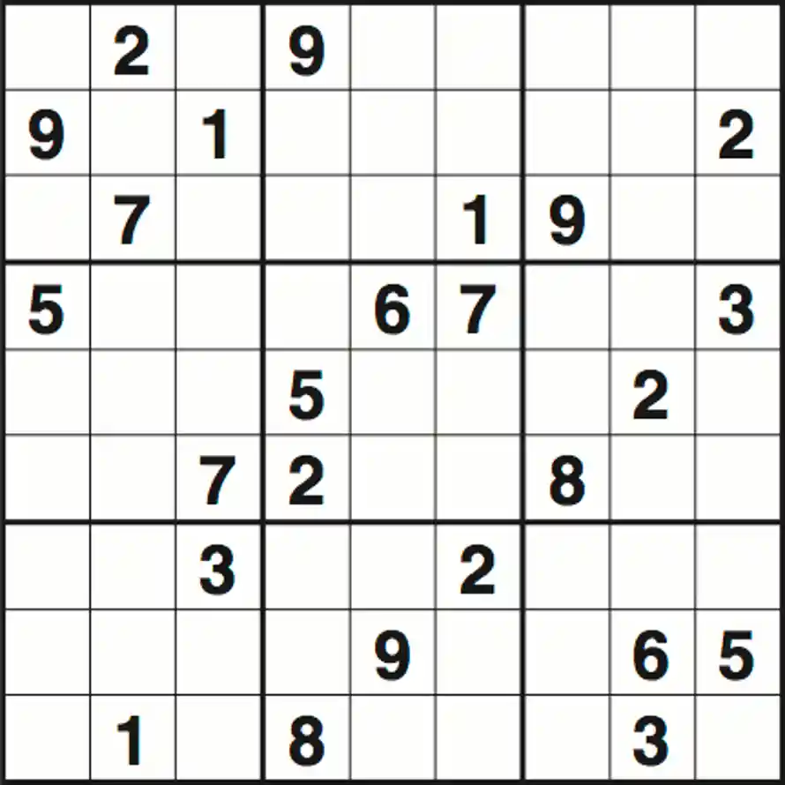
SuDoku Game & Solver
Member: Roz Wright
This Project will create a randomized Sudoku Board and a Solver file that will solve the Sudoku board.

Slide 2
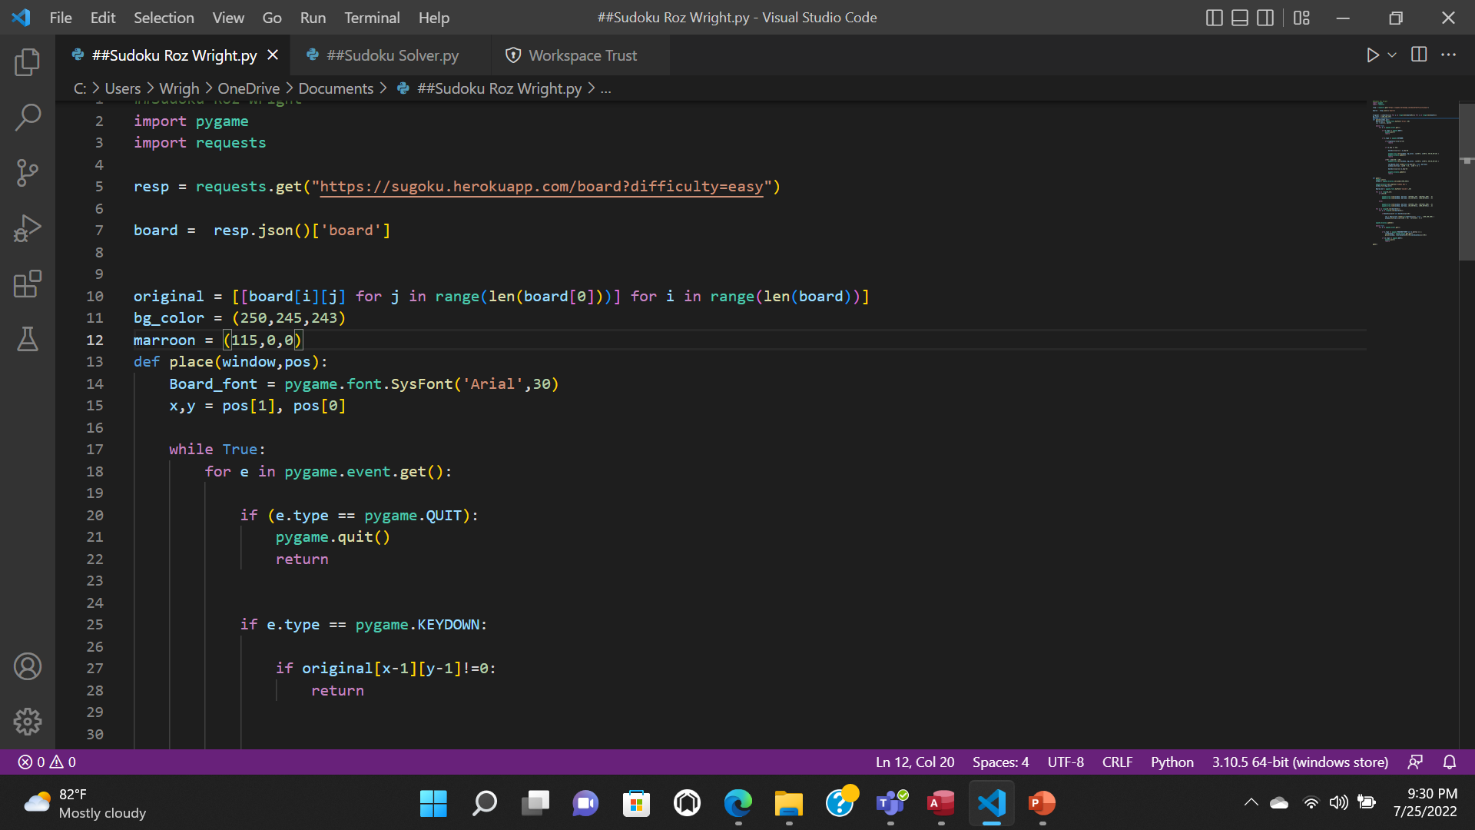
Challenge One: Importing Files and Interpreter
The beginning portion of this coding had the potential to now allow to code to work at all.
I was able correct by looking up trouble shooting methods.
Selecting the correct interpreter that allowed both import files to work properly fixed problem

Slide 3
Portions of Code: Board
This portion of the code created the board in the 1st Python file. It laid the base for where the solver would find the solution
This top portion created the board
Allows the user to quit the game
Enter a new value
Updating the cubes when a new digit is entered.

Slide 4
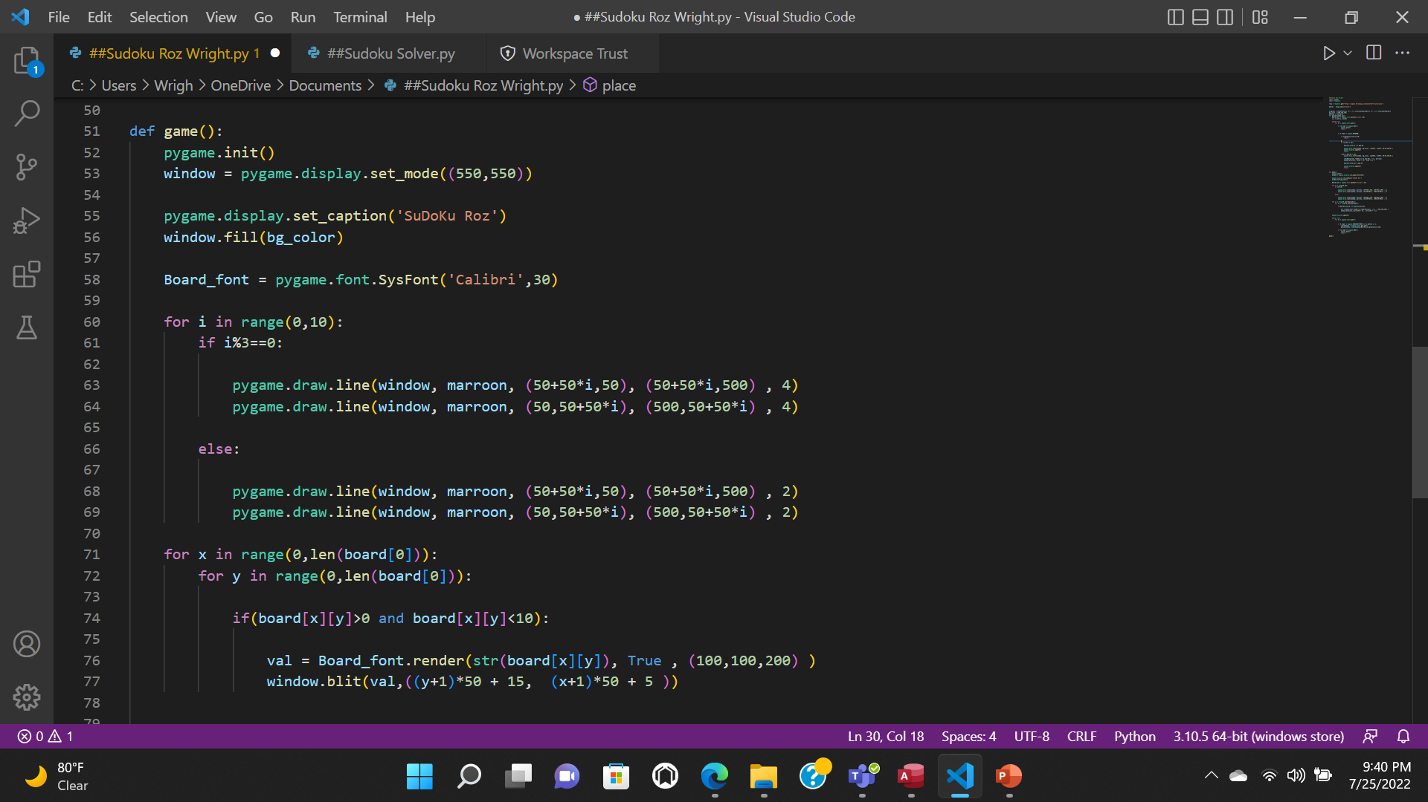
Portions of Code: Board
This portion of the code continues to build the board.
We add grid lines
Create the bold lines around each 3x3 sub section
Draw the remaining elements
Check whether the number entered is between 1-9

Slide 5
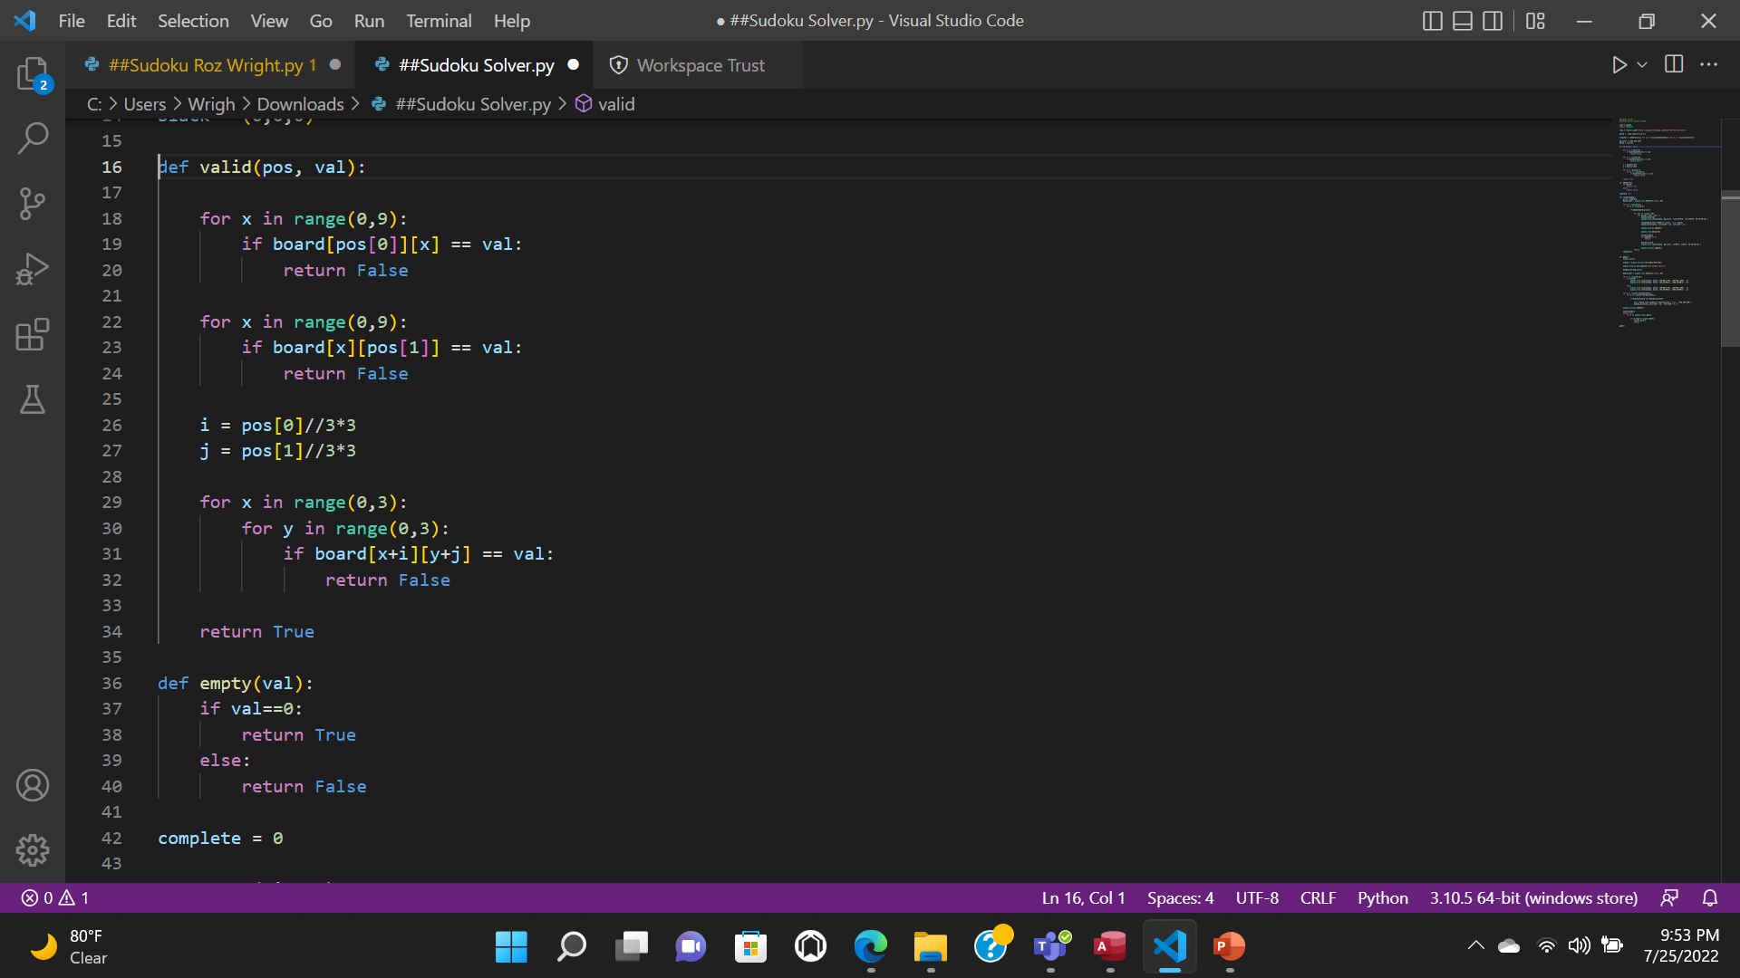
Portions of Code: The Solver
The Valid Function:
First checks if we can put value in the grid
Checks Rows
Checks Columns
Checks 3x3 Sub Set of the grid

Slide 6
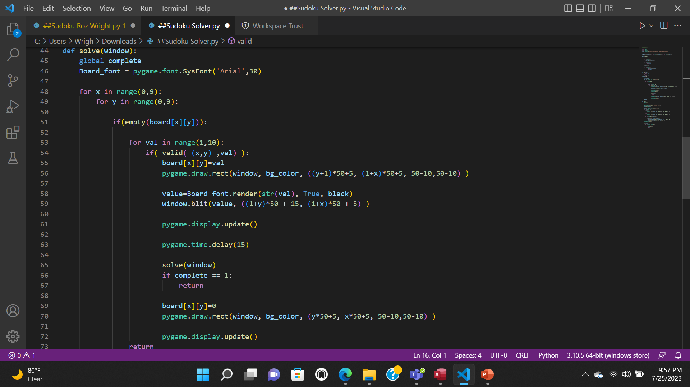
Portions of Code: Solver
Solve Function helps to solve the Sudoku by utilizing backtracking
It goes through all of the available values and determines if it can be placed there.
Once it find a value the fits it places it in the cube
Updates the window and continues for all other empty squares

